Slide 1
INSTRUCTION
How to use this template
In order to ensure you have consistent bullets and numbering throughout your presentation, please use the “Increase List Level” button in the Home Tab’s toolbar.
Do not use the “bullets” button.
Do not tab or manually indent.
Using the “increase list level” button will ensure you have the appropriate title size, the bullets are the right color and you have a consistent presentation from slide to slide.
Do not insert TEXT BOXES Simply copy and paste the example below when you need to insert a text box and you will maintain the correct formatting.
Use the “Increase List Level” button INSTEAD of using tab or indenting manual.
Body Title
Content
Bullet
Sub Bullet
Sub Bullet 1
Sub Bullet 2
Sub Bullet 3
Text Styles
Styles for title, body text and bullets are predefined in this template.
To use the next style, use the “Increase List Level” button in the Home Tab’s toolbar.

Slide 2
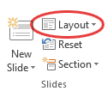
INSTRUCTION
Font
Use ARIAL font only.
Minimum font size is 14pts.
Colors
The palette of Battcon approved colors is embedded within the Theme of this template.
Layouts
There are different layout options available to use.
Click the “Layout” button in the Home Tab’s toolbar to select the most appropriate for your needs.

Slide 3
WELCOME TO BATTCON 2023
Orlando, FL | May 2023

Slide 4
Presentation Title Here
Speaker name and title

Slide 5
BATTCON Approved Template
This template must be used for BATTCON presentations
While other templates may be used, the company logo size (below right) should not be exceeded. In the event that an alternate template is used please insert the title and closing slide for conformity
Only one company logo per page
The BATTCON logo must appear on the slide
The Technical Committee may request changes to slide presentations to avoid overt commercialism

Slide 6
Preferred Header Size is 36 pt
Body text size can range from 24 point
To 22 point
To 20 point
To 18 point (please try not to use this 4th level of bulleting)
Test readability by viewing the slides ten feet from your computer screen. Keep tables at least 18 point text
You may vary text size, but readability in a large conference room is important
Try to follow the guidelines above
NOTE: These rules apply to text in graphics as well

Slide 7
Colors
You may change text and background colors, but the text and background colors selected in this template were chosen for readability in a large conference room
Avoid using too many colors in your presentation
Keep readability in a large room in mind if you make changes to background and text colors

Slide 8
Number of Slides
You are allotted 20 minutes to present
It typically takes 1 to 2 minutes to properly present a slide and for the audience to absorb it; therefore you generally should not exceed 20 slides
NOTE: If your presentation greatly exceeds 20 slides, the BATTCON Technical Committee may/will offer feedback

Slide 9
Additional information on Number of Slides
When you have a lot of info to convey, do not reduce the text size to fit it in 20 slides (see the previous comments about readability)
PowerPoint is not intended to include all the information in your paper – the audience will be able to read and reference all the content in the actual paper
PowerPoint is meant to highlight talking points (as a reminder to the presenter); it is not intended to be read line by line by the presenter

Slide 10
Removing Logos from Slides
When the information on a slide needs the maximum amount of space to be presented cleanly and readably:
You may remove the logos. Right click the slide thumbnail (in the bar to the left), select Format Background, check Hide Background Graphics, then click Close using the “X” in the upper right corner of panel (do not click “Apply to All”);
You may reinstate the red and black header line for the slide title by copying and pasting the lines from the slide master (to access slide master click on “View” in the upper menu bar, and then Slide Master);
Note that taking the above actions will result in the slide number disappearing

Slide 11
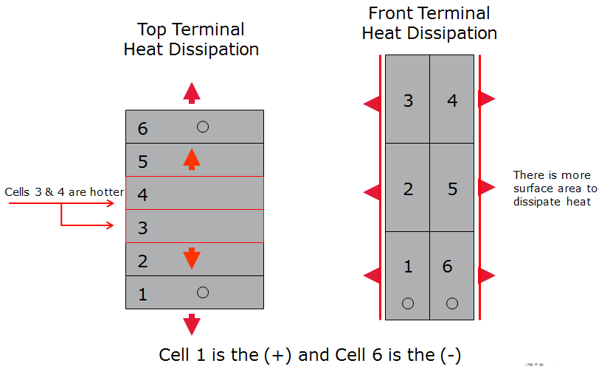
Examples: Inadequate Graphics
Text too small
Poor color/contrast choices
DLC
CO
O
E
<4 kft
<1 kft
SAI
ped
copper cable

Slide 12
Example: Good Graphics
Top Terminal Heat Dissipation
Front Terminal Heat Dissipation
3
4
6
5
There is more surface area to dissipate heat
Cells 3 & 4 are hotter
2
5
4
3
2
1
6
1
Cell 1 is the (+) and Cell 6 is the (-)

Slide 13
Example: unreadable Table
Text too small and not the best choice of text/background colors.
Manufacturer | Ideal Charge Voltage in volts per cell (VPC) | Tolerance VPC | Target Buss Voltage | Buss Voltage Range
Mfg 1 | 2.25 | ± .01 | 540VDC | 537.6 - 542.4VDC
Mfg 2 | 2.275 | ± .015 | 546VDC | 540 - 550VDC
Mfg 3 | 2.26 | ± .015 | 543VDC | 539 - 546VDC

Slide 14
Example: readable Table
Mfg. | Ideal Charge VPC | VPC Tolerance | Target Bus Voltage | Bus Voltage Range
Mfg 1 | 2.25 | ± .01 | 540 VDC | 537.6 - 542.4 VDC
Mfg 2 | 2.275 | ± .015 | 546 VDC | 540 – 550 VDC
Mfg 3 | 2.26 | ± .015 | 543 VDC | 539 – 546 VDC

Slide 15
Attention: please read
Photography and copyright infringement
Due to copyright laws, please refrain from searching for photography online and utilizing them in your presentations.
Using imagery from movies, television and pop-culture is illegal, unless purchased from a stock photography site or given expressed written.

Slide 16
Contact Info
If you wish, you may post your contact info on the final slide
You may include your name, company, address, email and/or telephone
Use of this last slide is optional

Slide 17
session evaluation
PLEASE LEAVE THIS SLIDE IN YOUR DECK, IT WIL BE UPDATED WITH THE LINKS TO THE EVALUATION PRIOR TO ONSITE DELIVERY

